Slide 1
Chapter 1: Introduction
Overview of ICT and Computer Science
Knowledge Hierarchy (Data, Information, Knowledge and wisdom)
What is an Information System?
Components of Information Systems
Applications of IS/ICT

Slide 2
Chapter 1
Computers and Communications: “These are the parents of the information age,” says one writer. “When they meet the fireworks begin.”
Computer Technology: A Computer is a programmable, multiuse machine that accepts data, raw facts, and figures, and processes or manipulates it into information we can use, such as summaries, totals, or reports. Its purpose is to speed up problem solving and increase productivity.
Notes:
Many scholars have come to the conclusion Global Economy is driven by technology (IT), based on information and knowledge production and dissemination.

Slide 3
Communications Technology: Communications, or Telecommunications technologies consist of electromagnetic devices and systems for communicating information over long distances. The principal examples are telephone, radio, broadcast television, cable TV, and other telecom technologies.
Information Technology (IT) is technology that merges computing with high speed communication links carrying data, sound, video, and other forms of multimedia.
Information Communications Technology (ICT) is a generic name used to describe a range of technologies for creating, finding, storing, gathering, retrieving, processing, analysing, sharing, and transmitting information
Notes:
Can you give examples of communication devices (technologies) used to transmit large amounts of data through long distances?
ICT can give countries something else to sell. What do you think it is?
Skilled man power as well as products and software!
We can say that ICT is about using IT for the benefits of society or groups of people.
We may consider IT as the infrastructure and ICT as applied on top to bring change: they are like body and soul.
ICT is an agent of change and IT is the tool embedded in it!
Sometimes we may loosely take IT and ICT as synonyms (another name for the other): as though both are referring to the same thing.
Thus, we use them interchangeably as they fit right based on our intellectual experience
ICT can be considered to be built on the 4Cs, Computing, Communications (Connectivity), Content (multimedia), and (human) Capacity
In my view, if we consider large areas and large groups of people (schools for example) ICT comes to the front,
while we consider organizations and industries IT comes to the front.

Slide 4
Cont…
The two technologies were developing independently, before they gradually fused together.
Why have the worlds of computers and telecommunications remained so long before coming together?
Technological Convergence, also known as digital convergence, is the technological merger of several industries through various devices that exchange information in the electronic, or digital format used by computers. The industries used are Computers, Communications, Consumer Electronics, Entertainment, and Mass media.
What are five developments growing out of the fusion of computers and communications? (refer to using information technology, 9th edition, Williams/Sawyer)
Notes:
Convergence describes the combining of several industries through various devices that exchange data in the format used by computers.
[Q] Can you give some examples of technologies that are results of convergence?
The Cloud, Internet telephony, and Internet through TV sets are some examples of convergence.
Other telecom services: such as broadband, VPN, etc.
Mass media: Television, Radio, and Newspapers.
The answer to the question is: Computers were digital while most of the world was analog.

Slide 5

What is Computer Science?
CS is designing computing devices and programming them
A lot of work in CS is done with pen and paper!
Computer science is the study of algorithms and much more than that …
A lot of computer science is about improving technology-- making it faster, smaller, cheaper or able to do new things through developing new theories.
Notes:
CS is about design.
Design is about architecture and abstraction of complex reality.
It is about developing new theories, as a result new technologies can be developed.
Software Engineering is a branch of Computer Science.
Computer science lays the ground for technology innovations by developing theories (concepts).
Principles (theories) have a long lifetime while technology tends to change every decade or so.
Algorithms are high level abstractions of computer programs.

Slide 6
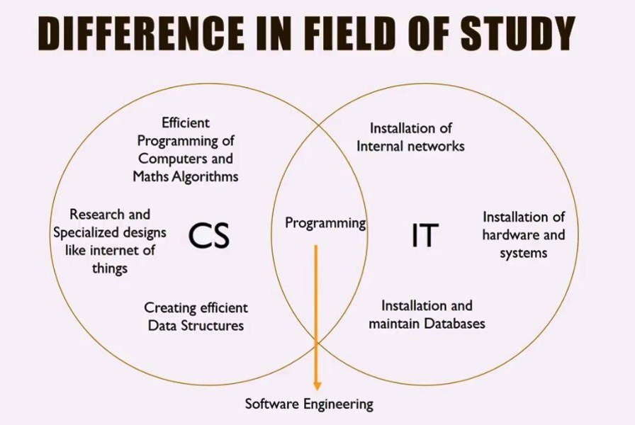
Notes:
IOT and cars! when you approach home the air conditioner will start working …
Trouble shooting through the internet.
Smart fridges, smart cars, smart homes;
Thinking is done in the left, Practical applications (of Computers and other Technologies) in the right side
At the overlapping region the two fields work together (through programming).
Successful software development is achieved through Software Engineering principles.
Software Engineering ➔ Software Architecture, Software Construction, Software Maintenance
Civil Engineering ➔ for a building for example: Architecture + Construction + Maintenance

Slide 7
Computer science is programming intensive
Involves
system architecture
software engineering
application programming
hardware engineering
theory
Information Technology is associated to organization related applications
business related
organizational automation
ICT is a Change Agent (Enabler)
Notes:
Architecture: The art or practice of designing and constructing
IT (HW & SW) supports organization processes!
Process → Activities (phases) → Tasks → techniques
Actually HW supports SW, and SW supports Processes (People and their activities)
Computer Science is about analytical thinking and logical reasoning.

Slide 8
Information Concepts
Notes:
Information technology (IT) is a general term that describes any technology that helps to produce (collect), manipulate, store, communicate, and/or disseminate information.
IT merges computing with high-speed communications links carrying data, sound, and video.
Usually Data and information are used interchangeably.
Sometimes Depending on type of recipient.

Slide 9
Data vs. Information
Data: raw facts and figures
Symbols + Rules (Syntax)
Representing events and/or objects or organization
has no meaning
By-product of doing business/transaction
Types of Data
Quantitative (Structured) /material
Qualitative (Unstructured) /textual, image, voice
Financial
Forms of Data
Quantity – weight in KG, volume in liter, …
Quality – taste, choice, …
Currency – Finance in birr, dollar, …
Notes:
40 degree Celsius and Red light are facts (data), have no concrete meanings (context or environment is missing).
We can not answer when, who, and were questions.
[Q] In an organizational setup lower position people use structured data (objective)
while at higher levels unstructured data (subjective) is used. Why is that?
The terms data & information are often used interchangeably. However, there is an important distinction: information is value-added data. Data is processed, organized or transformed to become information.
Data are raw facts. For example, if you write down your age & grade on an English test & hand it to me, I see 2 numbers – raw data. However, if you include the average age and average test score for your class, the data would have some meaning to me as a teacher… it would become information. Interestingly, your name and grade – data to me- could very well be information to you. In the context of your life or experiences, those 2 numbers alone would most likely have meaning.
Similarly, a grocery store manager would most likely find a list of every item sold today to be of little use – it is data. However, the amount that the store’s total sales are over or under planned sales would be information.
Business transactions are events that serve the mission of the business.

Slide 10
Information
Information: collection of facts organized in such a way that they have value beyond the facts themselves
It is data that has been refined and organized by processing and purposeful intelligence;
It is a resource created from a data to serve the management decision making needs of a business.
Sets of Data + meaning (Semantics)
(Sets of data) + (relational connection among data sets)
A red light is a form of data. But when we attach road traffic context to it, it becomes (i.e., STOP) information : Data + Context + Experience
“What we collectively know”
Cognitive state of awareness
Notes:
Semantics = Syntax + meaning
Cognition : The mental action or process of acquiring knowledge through thought, experience, and the senses.
Cognition : Mastewal (Amharic)
We can make decisions based on information we produce or acquire.
Information is one that derives from facts placed in right context with the purpose of reducing uncertainty.
Intelligence : the ability to acquire knowledge and skills.
People provide the purpose and the intelligence that produces the true information.
The data element “29-01-1986”, for example, may be seen as a string; in a particular context it may, however, be interpreted as the birthdate of a person, and people may use this information to congratulate this person on his birthdate.

Slide 11
Data versus Information
Data = raw facts that represent the characteristics of an event
Example 1:
Event: Air temperature
Data: 22° C
Example 2:
Event: Sale
Data: Sale’s date, item number, item description, etc.
Information = facts within a given context
Information results from transforming data by adding context to make it more useful.
The temperature today at noon in Addis was 22° C
P
I
O
Notes:
Information can answer the questions what?, when?, where?, who?. But not how?
If we consider ourselves as a living computer, what is our IPO?
Context = setting/background/environment
In the first example, when and where are added to get information.
The basic (main) operations (work flow activities) of computing : Input, Processing, Output, and storage.

Slide 12
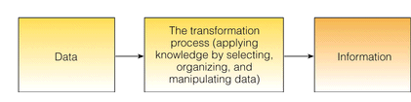
The Process of Transforming Data into Information
Notes:
Information is data that is processed using intelligence.
An ounce of Information is worth a pound of data.
A pound is approximately equal to 12 ounces.
Intelligence : the ability to acquire knowledge and skills.

Slide 13
Cont..
Knowledge
Once you spend some time interpreting and understanding a body of information, then you have knowledge
Information + understanding pattern
“What we individually know”, “Your Know-how”
There is information in a telephone book. The knowledge is understanding: Name - referring to a person (telephone subscriber), Number - referring to code enabling to operate the machine, How to use a telephone, How telephone circuit operates, etc
Information with Experience
Cognitive state beyond awareness
Notes:
Knowledge can also answer the question How?
Knowledge is about doing things right, but falls short of doing the right thing.
The sum of what is known. Synthesized set of information.
Facts, information, and skills acquired through experience or education;
The theoretical or practical understanding of a subject.
Information held on a computer system. (Knowledge-base, Database)
Knowledge is dynamic. Depends on memory, expertise, exposure, past experiences, opportunities, and the transfer mechanisms
It may be obsolete, you have to upgrade it.
Cognition : Mastewal++ (Amharic)
Pattern : a recurring regular form or sequence
Recurring : Occurring again and again

Slide 14
Cont…
The process of creating knowledge is time taking. Technology has greatly reduced the cost involved in assembling and storing data, and in transferring and storing information. Creating knowledge still takes human brain, human thoughts and time - especially today when there is too much information available
"You don't just learn knowledge; you have to create
it. Get in the driver's seat, don't just be a passenger.
You have to contribute to it or you don't understand
it." (Dr. W. Edwards Deming)
Notes:
Technology has not done anything to make the process of creating knowledge any quicker or cheaper.
You have to ask and debate to contribute.

Slide 15
Cont…
Wisdom
The state of being wise: Acting based on broader perspective, From self-interest towards social contribution, to create a better future grounded on the past experience;
Informed by multiple forms of intelligence : Reason, Intuition, Spirit, Values
Knowledge + Principles (ethics, Values)
What do we mean by Ethics?
Is there any possible knowledge hierarchy beyond wisdom?
Notes:
(not to be narrow minded) i.e. thinking out of the box
What type of questions can Wisdom answer? All types of questions including Why?
Ethics: The moral principle governing or influencing conduct. Moral: Concerned with the principles of right and wrong behavior
The highest form of common sense.
To be socially responsible (to be careful about the effects of your actions on other people).
Wisdom : The body of knowledge and experience that develops within a specific society or time (Oxford).
Having or showing experience, knowledge, and good judgement.
Not being biased!
Can an evil person be wise? No! According to definitions of wisdom.
Value: principles or standards of behaviour; one's judgement of what is important in life
:Consider something to be important or beneficial

Slide 16
The Knowledge
Hierarchy
Knowledge on Knowledge;
How, when, and where to apply knowledge
Wisdom
or
Meta-Knowledge
Knowledge: Understanding
of a domain can be applied to
solve problems (Pragmatics)
Information: Lower volume, higher
value, with context and associated
meanings
Data: Large volume, low value, usually no meaning or context
Noise: May contain irrelevant items which obscure data
Notes:
Wisdom is about doing the right thing without blindly following rules!
Information answers what? Knowledge answers How? Wisdom answers all the others including Why?

Slide 17
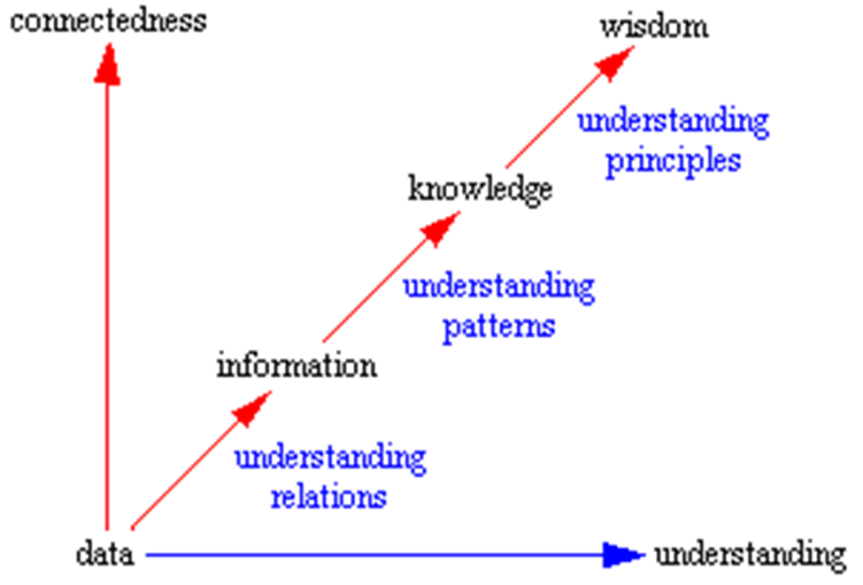
Notes:
As we go up, value increases and volume decreases.
Pattern : a recurring regular form or sequence
Recurring : Occurring again and again
The time it takes to convert data into information is short, information to knowledge is long, Knowledge to wisdom is much longer.

Slide 18
From Facts to Wisdom another form of the hierarchy
Increases as we go down
Increases as we go up
Notes:
Less is more : Compare Sand and Gold
Intelligence : The ability to acquire and apply knowledge and skills
Intelligent : Capable of learning

Slide 19
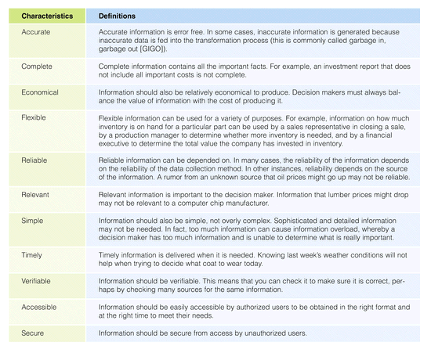
Characteristics of Valuable Information
Notes:
Reproducibility and Transparency can be added to this list, for example.
Transparency : Obvious or evident; Open to public scrutiny.
Ask questions about smaller, faster, and new things?
All that work goes into making technology that works for us. “CS is designing…”
Think about cell phones. They are just tiny computers. Any time you change the ring tone or screen background or launch an app you are running a computer program. A layer of software a human programmer wrote interprets your key strokes so the computer changes how it operates.
Have any of you ever wanted to make a phone work better or differently? [responses]. A lot of computer science is about improving technology-- making it faster, smaller or able to do new things. It’s powerful!

Slide 20
Reading Assignment
Read about tacit and explicit knowledge.
Read about knowledge management.
Notes:
Tacit & Codified Knowledge.

Slide 21
Chapter 1: Introduction
Overview of ICT, CS, and Software Engineering
Knowledge Hierarchy (Data , Information, Knowledge and wisdom) and Knowledge Management
What is a System? What is an Information System?
Applications of IS/ICT
Why study CS?
Notes:
What can you say about the meaning of a system? What is a system?
Can you give examples of a system?

Slide 22
What is a system?
Is a set of interrelated components interacting together to achieve a common goal.
Is a whole containing two or more interacting parts that each of which can affect the properties or behavior of the whole
Basic characteristics :
Emergent properties or behaviors, Hierarchy, Communications, Monitoring and Control Mechanisms
Input, output, environment, process, scope or boundary, objectives, sub-systems, interface, HW, SW, equipment, users;
No property of the Whole can be attributed to only single component of a system.
Notes:
In its simplest form, a system is a set of interrelated components, with a clearly defined boundary, working together to achieve a common set of objectives.
The output is monitored against a set of predefined performance criteria and control action is taken in all essential components if needed.
What is a user interface (UI or GUI)?
[Q] What is the objective of a college? As a system? To produce skilled and marketable graduates!
[Q] Can you signify the four characteristics of a system for humans? [Q] What are the emergent properties of a human system? Life; Our five senses, etc.
A system is a purposeful collection of interrelated components of different kinds that work together to deliver a set of services to the system owner and its users.
A system is an adaptive whole, according to the 4th characteristics!

Slide 23
Systems Thinking
A system is bigger than the sum of its components;
It’s a mind set or way of thinking to view the world (everything in the world) as a system.
It emphasizes on interaction that keeps the system alive.
Before changing the part, you have to demonstrate it improves the whole (Systemic thinking or systemic principle).
Today’s problems are the results of yesterday’s solutions.
Every solution creates new problems.
Notes:
Many systems are very complex to understand and to intervene! A different approach is required (Systems Thinking)
The whole is the product of the interactions of its parts not the sum of its parts taken separately.
It is greater than the sum of its parts. (Human, Car, Bicycle)
There is no total or complete solution for any problem (socio-technical and social systems),
We can only improve the situation. The cure can be worse than the disease (always there are side effects)
Someone’s terrorist is a freedom fighter for others.
Objective and Subjective truth. The hard and soft systems.
A system is a cognitive construct. [It is characterized or influenced by our thought!]
At very high speeds newton’s formulas are not correct! (different solutions for different contexts of the same problem)

Slide 24
Information systems
Are arrangement of people, data, process, interface, communication and IT that interact
to support and improve day-to-day operations in business
support the problem solving and decision making needs of management and users
Can exist with or without computers
Transform data in to useful information
Notes:
An information system (IS) can be any organized combination of people, hardware, software, communications networks, data resources, and policies and procedures that collects, stores, retrieves, transforms, and disseminates information in an organization.
Why do businesses need IS (and IT)? Currently, IS is supported by IT (CBIS).
To survive in the competition; To sustain their business; To do their work efficiently. To achieve their goal. Support decision making.
The architecture is not just about hardware, software, and telecommunications assets, though that is a key component. It encompasses the people, technology, processes, and data that make up information systems, and it should be driven by business requirements and the organization’s mission.
Patricia Wallace, Introduction to Information Systems, Page 81.

Slide 25
Cont…
Information technology can help all kinds of businesses improve the efficiency and effectiveness of their business processes, managerial decision making, and workgroup collaboration, which strengthens their competitive positions in rapidly changing marketplaces.
Notes:
IS is concerned with the processes that an enterprise can implement and improve using information technology (IT).
Computer Based Information systems (IS) is concerned with the information that computer systems can provide to aid a company, non-profit or governmental organization in defining and achieving its goals.

Slide 26
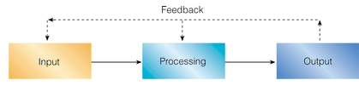
Simplified Information Systems diagram
A System is an adaptive Whole.
Notes:
This may be taken as the functional view of an IS (functional perspective).
Where does the adaptive behaviour of a system come from?
The output is monitored against a set of predefined performance criteria and control action
is taken in all essential components if needed.
Is there any problem associated with making changes through corrective actions?
Yes! The cure might be worse than the disease! Introduction of side effects or bugs (Systems thinking).
The basic (main) operations (workflow activities) of computing : Input, Processing, Output, and Storage.

Slide 27
Components of Computer Based Information Systems
Consider a system for email exchange and list the components participating in the process!
Computer Based Information Systems (CBIS) consist of the following components:
Hardware
Software
Databases (data / information)
Human resources (people )
Procedures (Process)
Telecommunications
Notes:
The data storage hierarchy in databases: Bits -> Characters -> Fields -> Records -> Files -> Database
A Database is a logically organized collection of interrelated data
Process (Procedures): tells about sequence of activities done and who does what using what (org. structure might be hidden here)
Logical : based on valid reasoning
Hardware + Software + Telecommunications = IT
The five classic components of a computer are input, output, memory, data-path, and control, with the last two sometimes combined and called
the processor. Computer Organization and Design 5th Edition.

Slide 28
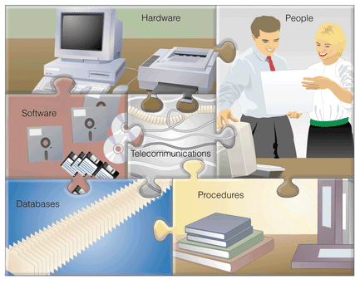
Components of a CBIS
Notes:
A Computer and Communications System (ICT Supported System) is made up of six elements: People, Procedures, Data/Information, HW, SW, and Communications.

Slide 29
Procedures: Strategies, policies, methods, and
rules for using a CBIS.
Telecommunications: Electronic transmission of signals for communication
Hardware: Computer Equipment
Software: Computer Programs
Databases: An organized collections of facts
People: Users, system analysts, programmers, CIO, etc.
Notes:
In some literatures telecommunications can be left out and put into HW & SW.
Procedures (Process) : Sequence of activities done to serve our clients, supported by all other components of the IS.
What will be the components if it were a manual IS?
CIO : Chief Information Officer

Slide 30
General Information Systems Diagram
Management Decisions
(Environment)
Database
Information System
Information
Used
Data
Input
Process
Output
Monitoring
& Control
Feedback
Notes:
This might correctly be called “General Information Systems Work Flow Diagram”??
Where does people, procedures, databases, HW, SW, and Communications fit in this picture?
The output is monitored against a set of predefined performance criteria
Feedback is the result of using and evaluating the system’s product in the environment.

Slide 31
Information Systems
The objectives of a system are realized in its outputs.
Outputs meet requirements of its stakeholders;
The components collect, process or transform, and disseminate data and information.
Manual or automated
Examples
Banking Systems, ERP, DSS/MIS; Airline Reservation Systems; Student Management Systems, HRM, Library Systems, Scheduler, SCM, TPS, Expert Systems, POS in groceries, GIS…
Notes:
Different stakeholders usually have different requirements, sometimes competing or contradicting, adding to system complexity.
Requirements may also be changing frequently for complex systems.
Packaged and in-house developed systems. In-house = within an organization
TPS can be mentioned here!
Departments : Production, sales and purchasing, Logistics, Human resource, Marketing, Finance, IT, Customer support
Transaction: an input message to a computer system dealt with as a single unit of work.
: an instance of doing business
SAP CRM (Customer Relationship Management)
SAP ERP (Enterprise Resource Planning)
SAP PLM (Product Lifecycle Management)
SAP SCM (Supply Chain Management)
SAP SRM (Supplier Relationship Management)
A system is a set of interrelated components (subsystems) that operate together to achieve a common goal.
An information system is a collection of related things that work together to achieve a common goal. The components collect, process or transform, and distribute data and information.
An information system is a specific type of system in general.
Common examples of information systems include: ATMs, point of sale (POS) systems used by grocery checkout clerks; information systems used by airlines to make reservations or schedule flights; and the system you use at your university to register for classes.

Slide 32
Information systems
Information systems use data stored in computer databases to provide needed information.
A database is an organized collection of interrelated data reflecting a major aspect of a firm's activities.
Information systems capture data from the organization (internal data) and its environment (external data).
Store the database items over an extensive period of time.
When specific information is needed, the appropriate data items are manipulated as necessary, and the user receives the resulting information.
Depending on the type of information system, the information output may take the form of a query response, decision outcome, expert-system advice, transaction document, or a report.
Notes:
Information systems are considered as the fundamental elements to achieve business objectives in order to dominate the market place.
Query : Ask a question about something.

Slide 33
Cont…
Data captured by information systems relates to
The operations of the organization internal information.
In a competitive market place, firms need to access more and more external information.
Environment (external data)
the stakeholders of a firm, which includes extended partners and external stakeholders.
Who are the stakeholders of a school?
Notes:
How can an organization collect external information? Using different information systems like a website and social media outlets.
Stakeholder : A person with an interest or concern in something.
Who are the internal and external stakeholders of a school?
Most of the data captured by information systems relates to the operations of the organization itself, serving to produce internal information.
But in an increasingly competitive marketplace, a firm needs to access more and more external information.
Therefore, it is important to note that decision makers need both. A firm can succeed only by adapting itself to the demands of its external environment.
The environment is represented by a number of groups that affect the company's ability to achieve its objectives or that is affected by it. Such groups are called the stakeholders of a firm, which includes both internal and external stakeholders.

Slide 34
Cont…
Effectiveness and Efficiency
The quality of the system may be evaluated in terms of its effectiveness and efficiency
Effectiveness measures the extent to which a system meets its objectives.
Efficiency is a measure of resources consumed to produce given outputs. The fewer resources a system consumes in producing given outputs, the more efficient it is.
Notes:
Efficiency : More output with the same input;
Same output with less input.
Or, even better, more output with less input.
Effectiveness : To make better decisions and to carry out them successfully.
: can be measured through customer and employee satisfaction (stakeholder satisfaction).
: can be measured using ROI = (estimated benefit – initial investment) / (initial investment)
Validation and Verification
An organization is an example of an artificial system.
It is a formal social unit devoted to the attainment of specific goals. It does not emerge naturally - it has to be organized.

Slide 35
Assignment 1
What are the characteristics that make information valuable? Why is each a critical attribute of information?
We all interact with various information systems every day; at the supermarkets, at different organizations, at school, even in cars. Make a list of the different information systems you interact with every day. See if you can identify the technologies, people, and processes involved in making these systems work.
What are the six primary roles that information systems play in organizations? How are information systems used in each context? Refer to Introduction to information systems, Patricia Wallace, 2nd edition.
Notes:
Use Microsoft word or other composing tool to write your answers and submit a printed copy of your work.
Use header and footer, for example, to make it more attractive and informative!

Slide 36
Exercises Cont …
Moodle is an open source learning management system that is used by millions of people worldwide. It is also known as a course management system (CMS) or a virtual learning environment (VLE). Make investigations and write a short paragraph about Moodle. Do you think you can install, configure, and run Moodle at this level of your knowledge? If you manage to do it you can show me and earn bonus!
Make investigations about ERP and Electronic Commerce Systems and write a couple of paragraphs explaining them.
Notes:
Use Microsoft word or other composing tool to write your answers and submit a printed copy of your work.
Use header and footer, for example, to make it more attractive and informative!

Slide 37
Exercises Cont …
N.B.
Use Microsoft word or other composing tools to write your answers and submit a soft copy of your work to abedris@yahoo.com.
Use header and footer, for example, to make your document more attractive and standards based.
Copying others’ work is not allowed. Refer to resources and discuss ideas with others but submit your own answers.
Concise and Precise answers are adequate and recommended.
Due date : Saturday 21 November 2020.
Notes:
Different levels of decision making in an organization rely on different mixes of structured and unstructured information.

Slide 38
Chapter 1: Introduction
Overview of ICT, CS, and Software Engineering
Knowledge Hierarchy( Data , Information, Knowledge and wisdom) and Knowledge Management
What is a System? What is an Information System?
Applications of IS/ICT
Why study CS / SW Engineering?
Notes:
Organizations that serve customers of any kind need information systems to manage operations and build enduring relationships.
Types of Information Systems : Information Systems are classified ➔ (1) based on Business types : Airline Reservation Systems, Banking Systems, SIS, Library Systems, and so on. ➔ (2) Based on business functions : HR, Accounting & Finance, Sales & Marketing, Customer Support, Production, IT, and so on. SCM, CRM, HRM, ERP ➔ (3) Based on user types (roles and positions in the organizational structure) : TPS (ERP), DSS, CAD/CAM, MIS, DSS, EIS/ESS
Some systems like ERP and MIS are crosscutting applications.

Slide 39
Information Systems in Business IS supports Businesses (Organizations)
Business functions (horizontal)
Buy, Make, Sale, Keep track, support, financial matters, people matters, etc.
Business processes
A series of interrelated activities through which work is organized and focused to produce a product or service
Business levels (vertical)
Strategic (lead people, long term planning)
Tactical (coordinate , short to medium term planning)
Operational (supervise, monitor, and customer services)
Notes:
By organizational Structure, and by support provided. [Functional areas and Managerial levels]
Departments : Production, sales and purchasing, Logistics, Human resource, Marketing, Finance, IT, Customer support
Process : Sequence of activities done to serve clients, supported by all other components of the IS.
: Sequence of activities done and who does what using which resources
Companies that handle these processes well gain an edge over competitors by reducing costs, adding value, and satisfying employees and customers.
What is the relationship/difference between IS and IT (ICT)?
IS applies IT to accomplish the assimilation, processing, storage, and dissemination of information.

Slide 40
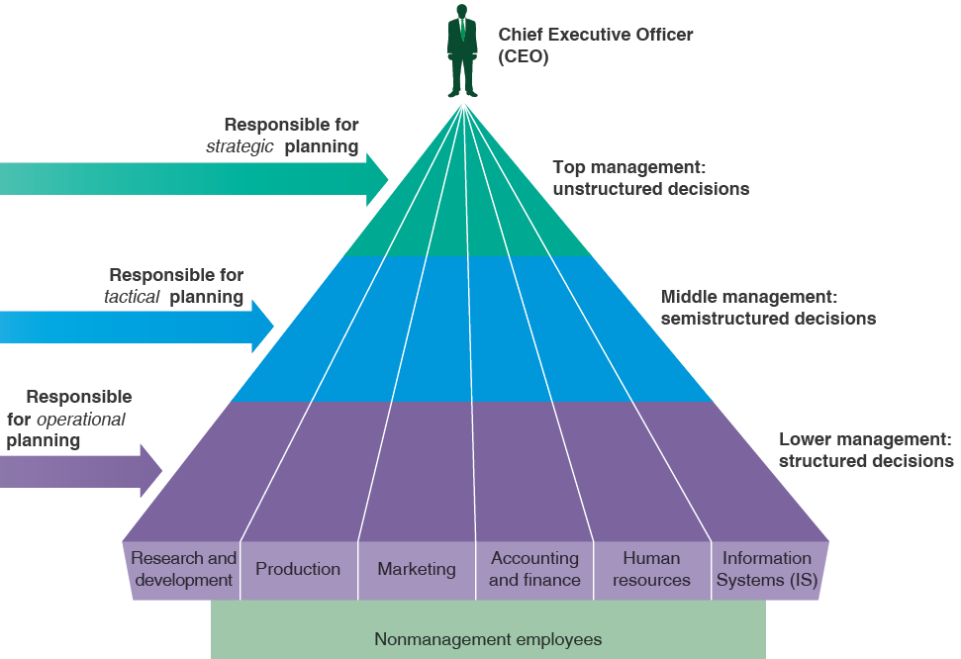
Six departments and Three management levels to which information must flow in an Organization
Notes:
Information Flows within an Organization: Horizontally between Departments & Vertically between Management Levels
Information is used by management at different levels for supervising, controlling, planning and decision making.
Strategic decisions are complex decisions rarely based on predetermined routine procedures (Dynamic not Static);
They involve the subjective judgment of the decision maker.
Tactical, or middle-level managers, make tactical decisions to implement the strategic goals of an organization.
A tactical decision is made without a base of clearly defined informational procedures.
Operational, or low-level (supervisory level), managers make operational decisions—predictable decisions that can be made by following well-defined sets of routine procedures.
Organizational structure pyramid
Refer to Using Information Technology, 9th edition for more information.

Slide 41
Information Systems Applications in an Organization
Decisions
Management Levels
Types of Information Systems
Unstructured
Senior Management
ESS, EIS
Strategic
DSS
Knowledge and Data Workers
GIS, CAD/CAM
Tactical
Semi-structured
Middle
Management
MIS
OAS
Lower
Management
TPS
Technical
(Operational)
Buy
Make
Sell
Keep
Track
Functions
Structured
Non management Employees
Notes:
Different levels of decision making in an organization rely on different mixes of structured and unstructured information.
OAS: Office Automation Systems (also called OIS)
CAM: Computer aided modeling
By organizational Structure, and by support provided
Departments : Production, sales and purchasing, Logistics, Human resource, Marketing, Finance, IT, Customer support
TPS keeps track of the transactions needed to conduct business.
Transaction: an input message to a computer system dealt with as a single unit of work, an instance of doing business.
The database of transactions stored in a TPS provides the basis for MIS and DSS.
MIS uses data recorded by a TPS as input into programs that produce routine reports as output.
MIS draws from all six departments or functional areas, not just one.
MIS Supports more structured (semi structured) decisions (Summarized reports of all functional areas)
Also called an executive information system (EIS), an executive support system (ESS)
Is an easy-to-use DSS made especially for strategic managers;
It specifically supports strategic decision making. Combines many features of MIS and DSS
Organizational structure pyramid

Slide 42
GIS
DSS that uses geographic databases to construct and display maps and other graphics displays that support decisions affecting the geographic distribution of people and other resources
Often used with Global Position Systems (GPS) devices
Office information systems (OISs), also called office automation systems
(OASs), combine various technologies to reduce the manual labor required in operating an efficient office environment and to increase productivity. Used throughout all levels of an organization, OIS technologies include fax, voice mail, email, scheduling software, word processing, and desktop publishing, among others.
The backbone of an OIS is a network—LAN, intranet, extranet—that connects
everything. All office functions—dictation, typing, filing, copying, fax, microfilm and records management, telephone calls and switchboard operations—are candidates for integration into the network.
Notes:
?What are the resources used in an Information System?
?What are the activities performed using these resources?
Tactical : Short to medium term planning
Operational : Customer Services

Slide 43
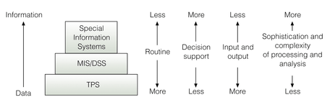
TPS, MIS/DSS, and Special-Purpose Information Systems
Notes:
Based on different criteria (from different points of view) Information Systems can be characterized as shown in the picture.
Routine: Something repetitive
EIS or ESS: A kind of DSS specialized to the needs of top executives
Each department or functional area of an organization usually has its own TPS.
MIS : System to provide managers with summaries of decision-relevant information
The MIS draws from all departments or functional areas, not just one.
A decision support system (DSS) is a computer-based information system that provides a flexible tool for analysis and helps
managers focus on the future
Analysis : detailed examination of the elements or structure of something.

Slide 44
Administrative Information Systems
Transaction Processing Systems (TPS)
Basic business system that serves the operational level in an organization
Office Automation Systems (OAS) also OIS
Systems designed to help office workers in doing their job (fax, voicemail, email, document processing, etc.)
Decision Support Systems (DSS)
Systems designed to support middle managers and business professionals during the decision-making process
Executive Information Systems (EIS) or Executive Support Systems (ESS)
Specialized DSS that help senior level executives make decisions.
GDSS: computer-based systems that facilitate solving of unstructured problems by set of decision makers
Notes:
Each department or functional area of an organization usually has its own TPS.
MIS : System to provide managers with summaries of decision-relevant information
The MIS draws from all departments or functional areas, not just one.
A decision support system (DSS) is a computer-based information system that provides a flexible tool for analysis and helps
managers focus on the future
ESS: A specialized DSS that includes all the hardware, software, data, procedures, and people used to assist senior-level executives within the organization
Future orientation (predictions, forecasting)
EIS: A kind of DSS specialized to the needs of top executives

Slide 45
DSS structure
User Interface
Systems designed to help middle managers make decisions
Major components
Data management subsystem
Internal and external data sources
Analysis subsystem
Typically mathematical in nature
User interface
How the people interact with the DSS
Data visualization is the key
Text
Graphs
Charts
Analysis
- Sensitivity Analysis -> What-if Analysis
-> Goal-seeking Analysis
Data-driven tools
-> Data mining
-> OLAP*
Data Management
- Transactional Data - Data warehouse - Business partners data - Economic data
* OLAP: OnLine Analytical Processing
Notes:
Analysis : A detailed examination of something in order to explain it.
The process of separating something in to its constituent elements
Often contrasted with Synthesis : The combination of components to form a connected whole.
OLAP :
* Enables mangers and analysts to examine and manipulate large amounts of detailed
and consolidated data from many perspectives
* Done interactively in real time with rapid response
Offers both textual and graphical visualization
A DSS aims to produce collected information known as business intelligence.

Slide 46
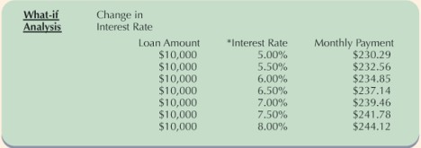
DSS’ Model Management Tools
Simulation is used to examine proposed solutions and their impact
Sensitivity analysis
Determine how changes in one part of the model influence other parts of the model
What-if analysis
Manipulate variables to see what would happen in given scenarios
Goal-seeking analysis
Work backward from desired outcome
Determine monthly payment given various interest rates.
Notes:
The period of payment should have been indicated here! Term in months (or in years)
For example, within 4 years.
→ DSS offers potential to assist in solving semi-structured and unstructured problems.
→ Can you give examples of unstructured problems?
Possible answers : Health related problems and social problems, for example.
Because different problems may have similar symptoms, and the cure might even create more problems.
What is the name given to such type of concepts? Systems thinking.
→ Relationships among data are not always clear, and the data may be in a variety of formats

Slide 47
Expert Systems Components (a set of interactive computer programs that helps users solve problems that would otherwise require the assistance of a human expert in a given problem domain)
Knowledge base: database of the expertise, often in IF THEN rules.
Inference engine: derives recommendations from knowledge base and problem-specific data
User interface: controls the dialog between the user and the system
Explanation system: Explains the how and why of recommendations
User
Example of rules
Domain Expert
IF temperature is below 35 degrees AND the dew point is below 28 degrees AND it is 3am or later THEN turn on cold protection devices
IF temperature < 25 THEN issue warning messages
User Interface
Expertise
System Engineer/ System Developer
Inference Engine
Knowledge Engineer
Encoded expertise
Knowledge base
Explanation Sub-System
- Knowledge engineer codify the human expert’s expertise into the systems’ knowledge base. - System engineer is the IT professional who develop the user interface, the inference engine, and the explanation system.
Notes:
An expert system, or knowledge-based system, is a set of interactive computer programs that helps users solve problems that would otherwise require the assistance of a human expert in a given problem domain or in a particular subject area.
Inference : a conclusion reached on the basis of evidence and reasoning.
A knowledge base is an expert system’s database of knowledge about a particular subject.
Knowledge base : If-then-Else rules (or If-Else rules), including relevant facts;
IF this happens, do this, ELSE do that. Most Expert systems may have tens of thousands of such rules.
Inference Engine : Software that controls the search of the expert system’s knowledge base and produces conclusions.
In some architectures the Explanation system can be part of the Inference Engine.
Inference: Conclusion; Reasoning Process; Implication
→ Both DSS and Expert Systems are applications of AI.

Slide 48
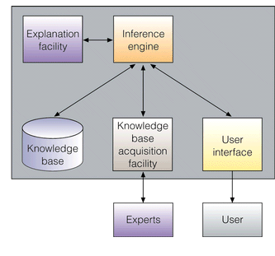
Components of an Expert System
Notes:
Here the knowledge engineer is replaced by a Knowledge base acquisition component (module).
An expert system mimics the reasoning of a human expert, drawing from a base of knowledge about a particular subject area to come to a decision or recommendation.
Application of Artificial Intelligence
Expert systems are systems that employs knowledge about its application domain
uses an inferencing (reasoning) procedure to solve problems that would otherwise require human competence or expertise.

Slide 49
Why Learn Computer Science and Information Systems?
Advance in your career
Solve problems
Realize opportunities and change
Meet your career goals
Information systems and technologies are vital components of successful businesses and organizations -- some would say they are business imperatives.
Notes:
To have a hands on and real world approach to software development.
To study the design, development and analysis of software and hardware used to solve problems in a variety of business, scientific and social contexts.
Access → Information → Knowledge → Opportunities

Slide 50
Exercises
What is supply chain management (SCM)? What is the most important metric in supply chain management? What does it measure? What are examples of supply chain management software? How is each used to support supply chain processes?
What is customer relationship management (CRM)? What are the objectives of CRM? How do organizations measure their customer relationship? How do information systems support each objective of CRM? What are three basic categories of CRM technologies? How do information systems support activities in each area?
Why are ERP systems important to organizations? What are the typical components of an ERP system? What is meant by the term “a suite of suites”? What are three approaches to ERP integration? What are some of the issues associated with an ERP implementation? What is the success rate for ERP implementation? What is the primary benefit of a successful ERP implementation?
Notes:
Refer to Patricia Wallace: Introduction to information Systems

